Slide 1



CYBERSECURITY FUNDAMENTALS AND NETWORK SECURITY
Unit-02
NETWORKING FUNDAMENTALS
Created by:
Email Address:
Gayathri Gagana
gayathri.g@techdefence.com

Slide 2
CONTENT
OSI Model
Security Attacks Across OSI Layers – Layer 2,3,4 and 7
TCP/IP Model
TCP 3-way Handshake
TCP vs UDP
IP Addressing – IPV4 & IPV6, Public and Private, Subnetting, CIDR and NAT

Slide 3
CONTENT
Well Known Ports and Protocols
Open Ports as Attack Surface and Port Scanning
DNS Resolution Process, Record Types and Poisoning Concepts
HTTP v/s HTTPS
Digital Certificates
Packet Flow

Slide 4
OSI MODEL
What is the OSI Model?
The OSI(Open Systems Interconnection) model is a 7-layer conceptual framework that standardizes the functions of a telecommunication or computing system.
It was developed by the International Organization for Standardization (ISO) in 1984 and serves as a guide to understanding and designing network protocols and communication systems.
Each layer is independent of the others but collaborates to ensure that data is transmitted efficiently.

Slide 5
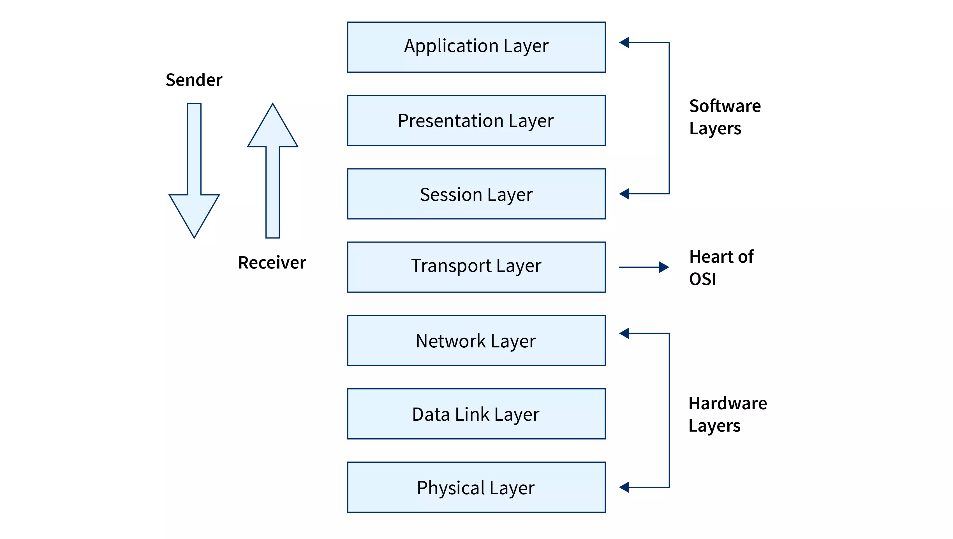
OSI MODEL

Slide 6
OSI MODEL
Why is the OSI Model Important?
Standardization: The OSI model provides a universal set of guidelines for manufacturers and developers to follow, which ensures compatibility between different networking products and systems.
Modularity: Each layer of the OSI model has specific tasks, which allows for modular design and troubleshooting in network systems.
Understanding Data Flow: It helps network administrators and engineers understand the complete flow of data from source to destination, which aids in network management and troubleshooting.

Slide 7
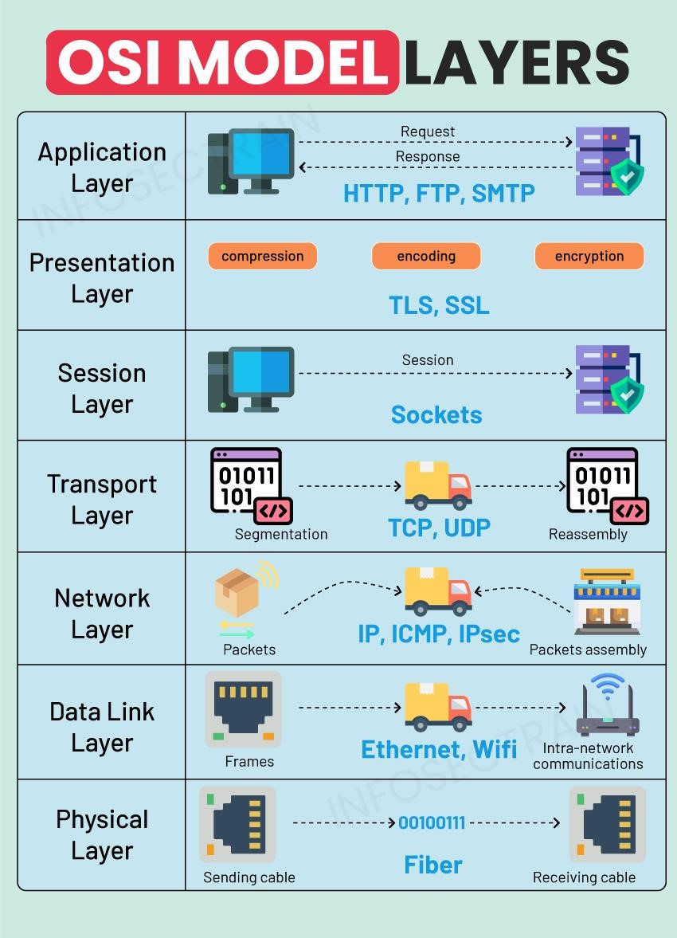
OSI MODEL

Slide 8
PHYSICAL LAYER
The Physical Layer is the foundation of the OSI model. It deals with the physical transmission of data over a medium (e.g., cables, fiber optics, radio waves). It governs the electrical, mechanical, procedural, and functional specifications for activating and maintaining physical connections.
Function: Transmits raw bits (0s and 1s) over the network. It converts digital data into electrical, radio, or optical signals.
Examples of Physical Layer Devices: Cables, hubs, repeaters, modems, network interface cards (NICs).
Key Protocols: Ethernet (physical signaling).

Slide 9
PHYSICAL LAYER
Key Characteristics:
Data rate (bits per second, Mbps, or Gbps).
Physical medium (copper wires, fiber optics, wireless).
Signal modulation (AM, FM, etc.).
Real-World Example: When a user clicks "send" on an email, the electrical signals or light pulses travel over cables or through the air to the recipient's device.

Slide 10
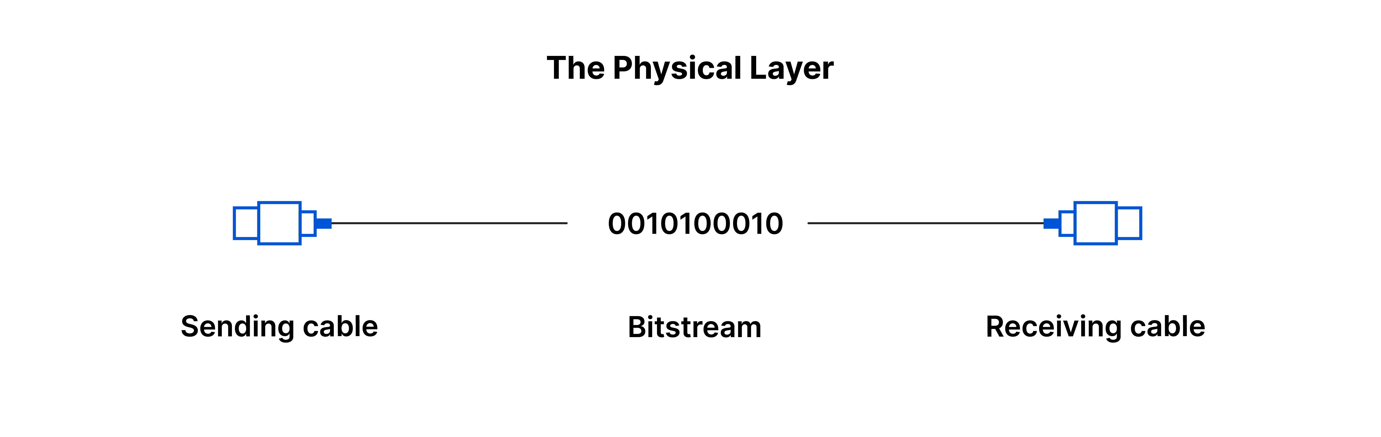
PHYSICAL LAYER

Slide 11
DATA LINK LAYER
The Data Link Layer is responsible for node-to-node data transfer. It ensures reliable transmission of data across the physical link by framing data and handling errors that may occur at the Physical Layer.
Function: Packages raw bits from the Physical Layer into frames. It also manages error detection, flow control, and addressing (MAC addressing).
Key Concepts:
MAC (Media Access Control): Unique addresses that identify devices on a network.
Framing: Dividing data into packets called frames.
Error Detection: Using Cyclic Redundancy Check (CRC) to detect any errors in transmission.

Slide 12
DATA LINK LAYER
Examples of Data Link Layer Devices: Switches (operating in Layer 2), bridges, Network Interface Cards (NICs).
Key Protocols: Ethernet (for LANs), Wi-Fi (for wireless networks), PPP (Point-to-Point Protocol).
Real-World Example: When sending a message, the Data Link Layer adds MAC addresses so that the message knows which devices to travel through, ensuring it reaches the correct recipient within a local network.

Slide 13
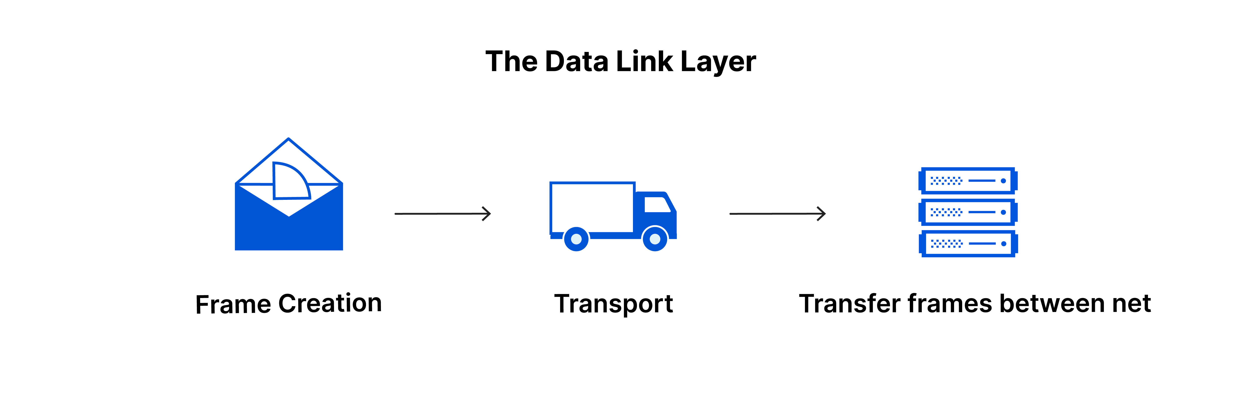
DATA LINK LAYER

Slide 14
NETWORK LAYER
The Network Layer is responsible for routing data between different networks. It determines the best path for the data to travel to its destination using logical addresses, such as IP addresses.
Function: Routing and forwarding of packets from the source to the destination across different networks.
Key Concepts:
IP Addressing: Assigning logical addresses to devices.
Routing: Finding the best path for data packets to reach their destination.
Packet Switching: Data is broken into packets, which are then routed to their destination.
Network Address Translation (NAT): Converts private IP addresses to public IP addresses for communication over the internet.

Slide 15
NETWORK LAYER
Examples of Network Layer Devices: Routers, Layer 3 switches.
Key Protocols: IP (Internet Protocol), ICMP (Internet Control Message Protocol), OSPF (Open Shortest Path First), BGP (Border Gateway Protocol).
Real-World Example: When you type a website URL, the Network Layer uses your IP address to determine the best route to send and receive data from the website's server.

Slide 16
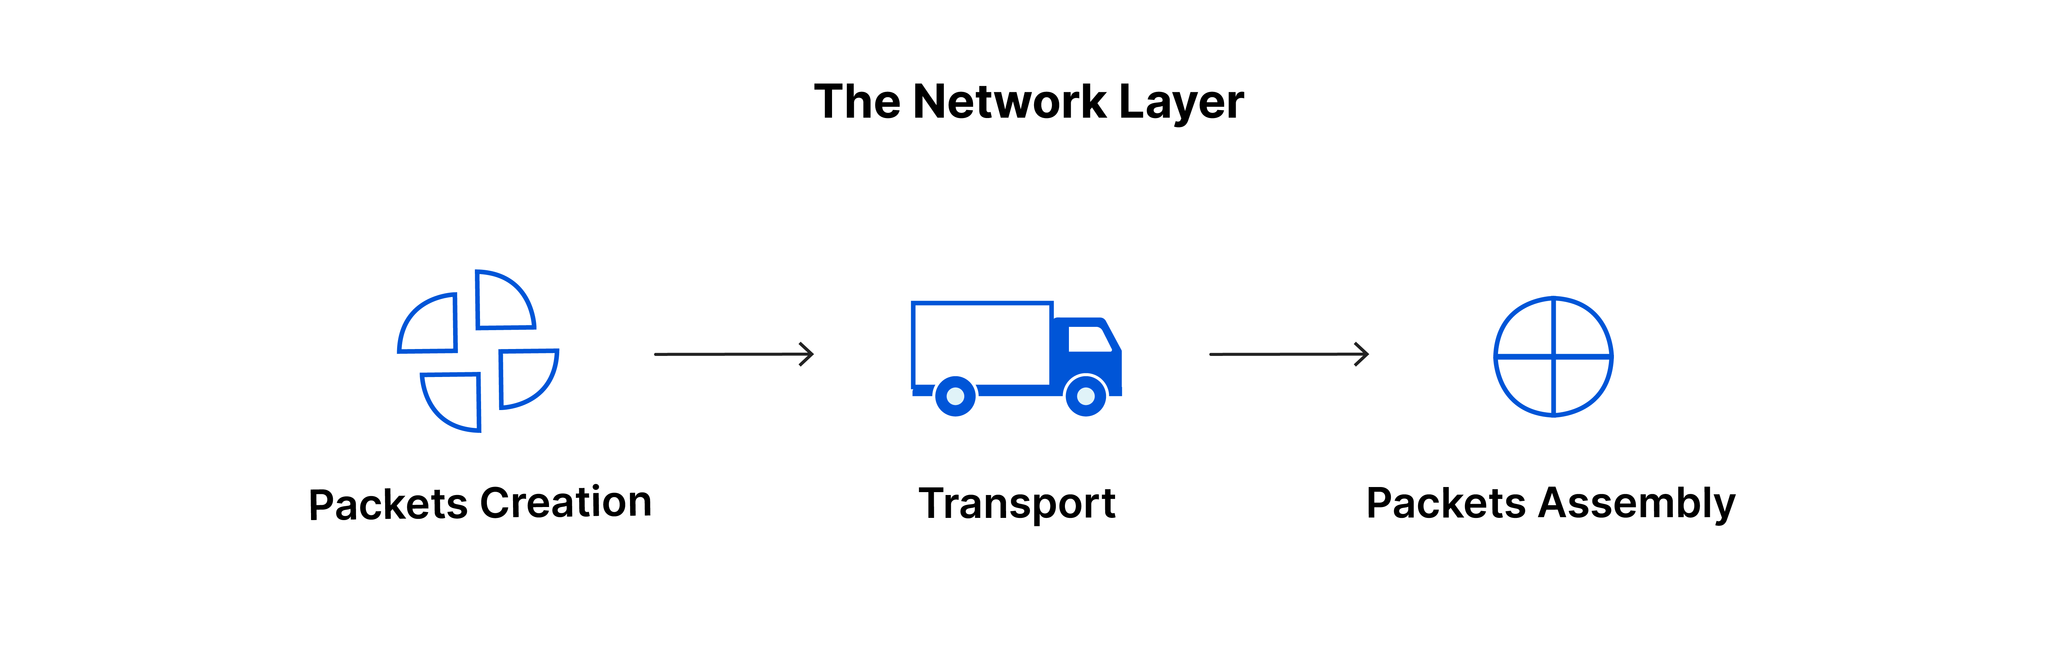
NETWORK LAYER

Slide 17
TRANSPORT LAYER
The Transport Layer ensures end-to-end communication and error recovery. It controls the flow of data between devices and ensures that the entire message is sent and received in the correct order.
Function: Provides reliable transmission of data across the network and ensures error checking and data flow control.
Key Concepts:
TCP (Transmission Control Protocol): A connection-oriented protocol that guarantees data delivery through error checking and retransmission of lost packets.
UDP (User Datagram Protocol): A connectionless protocol used when speed is more important than reliability (e.g., for live streaming or VoIP).
Segmentation and Reassembly: Divides large messages into smaller segments for transmission, reassembles them at the destination.

Slide 18
TRANSPORT LAYER
Examples of Transport Layer Devices: Transport layer functions are implemented in operating systems.
Key Protocols: TCP, UDP.
Real-World Example: When you download a large file, TCP ensures that every packet of the file is delivered correctly, and if some are lost, it requests them again.

Slide 19
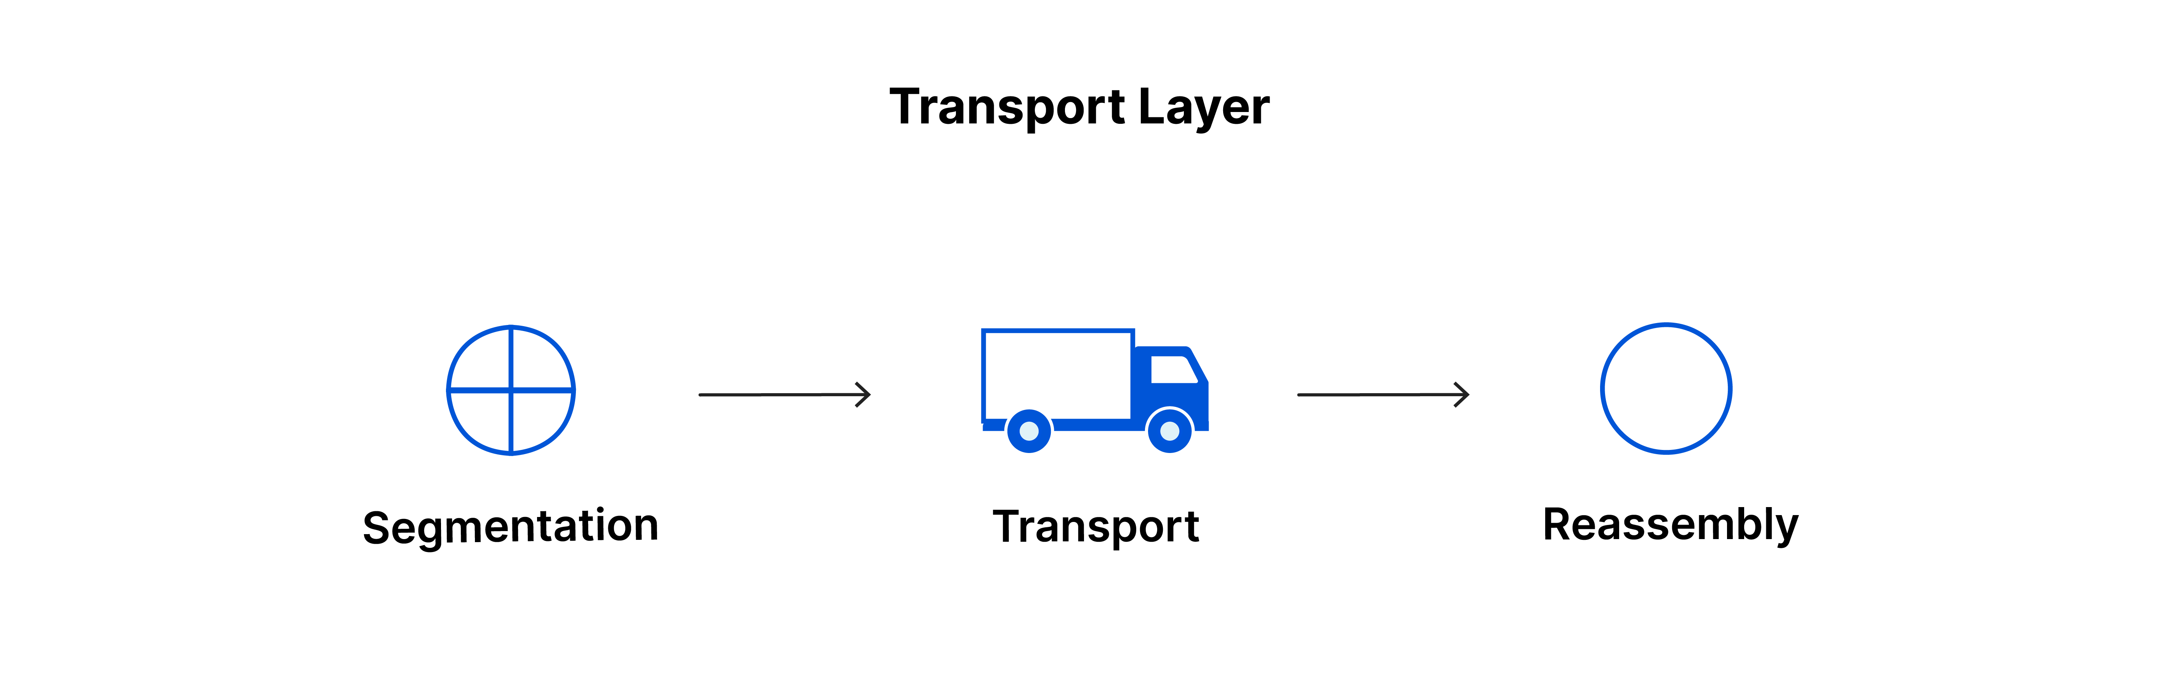
TRANSPORT LAYER

Slide 20
SESSION LAYER
The Session Layer is responsible for establishing, managing, and terminating sessions (connections) between devices. It ensures that communication sessions between applications stay open and synchronize the data exchange.
Function: Manages sessions between devices, including establishing, maintaining, and terminating connections.
Key Concepts:
Session Management: Controls dialogue between devices.
Synchronization: Ensures that data streams are synchronized between the source and the destination.
Dialog Control: Manages which device can send and receive data at a given time (full-duplex or half-duplex).

Slide 21
SESSION LAYER
Examples of Session Layer Devices: No specific devices—these functions are typically handled by the operating system.
Key Protocols: SMB (Server Message Block), PPTP (Point-to-Point Tunneling Protocol).
Real-World Example: When you're logged into a website, the session layer keeps the session open, allowing you to interact with the website until you log out or the session times out.

Slide 22

SESSION LAYER

Slide 23
PRESENTATION LAYER
The Presentation Layer is responsible for translating data between the application layer and the lower layers of the OSI model. It formats data so that it can be correctly interpreted by the receiving device. This layer also handles encryption, decryption, and compression.
Function: Translates data into a format that can be understood by both the sending and receiving devices. Handles encryption and compression.
Key Concepts:
Data Formatting: Converts data into a readable format (e.g., converting from EBCDIC to ASCII).
Encryption/Decryption: Encrypts data for secure transmission and decrypts data at the destination.
Compression: Reduces the size of data to make transmission faster.

Slide 24
PRESENTATION LAYER
Examples of Presentation Layer Devices: No specific devices—functions are typically handled by software (e.g., codecs, encryption tools).
Key Protocols: SSL/TLS (for encryption), JPEG, MPEG (for data formatting).
Real-World Example: When you use a secure website (HTTPS), the Presentation Layer handles encryption so that your personal data remains secure while it’s transmitted.

Slide 25
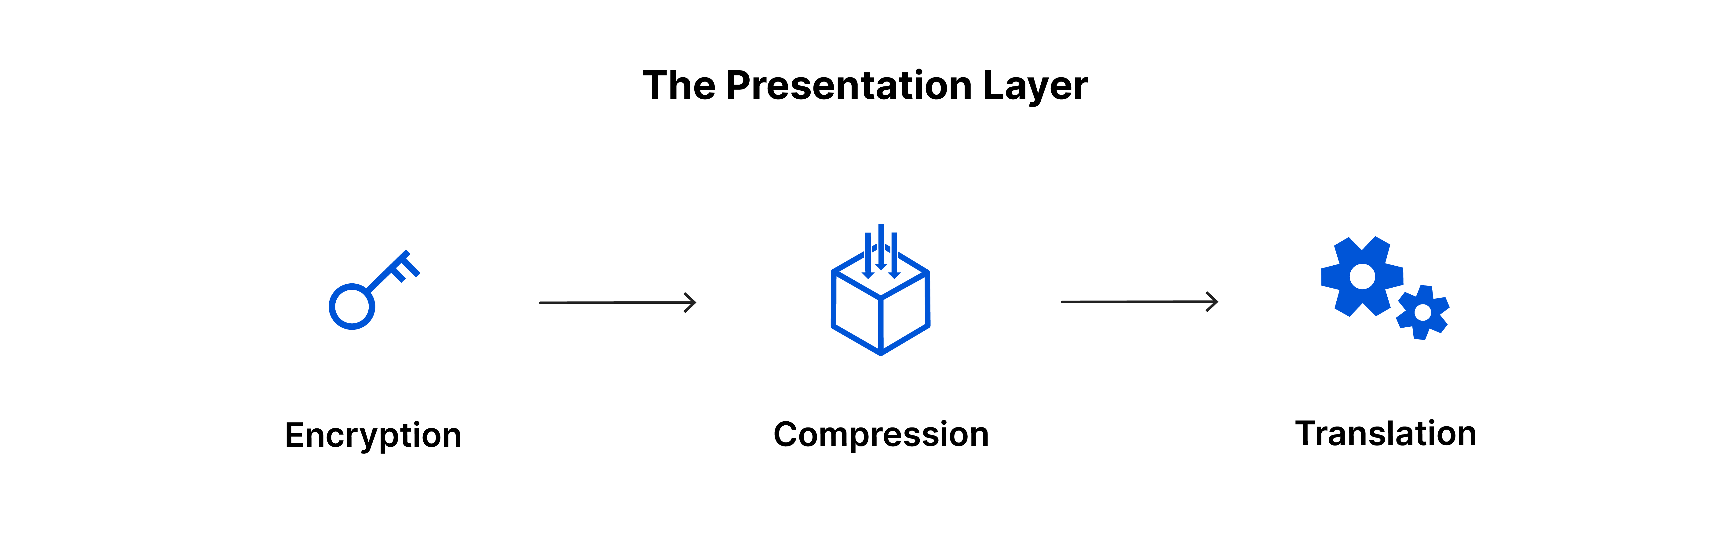
PRESENTATION LAYER

Slide 26
APPLICATION LAYER
The Application Layer is the topmost layer of the OSI model and interacts directly with the end user. It provides network services like email, file transfer, and web browsing.
Function: Provides network services to end-user applications. This is the layer where applications like web browsers, email clients, and file transfer utilities operate.
Key Concepts:
Application Services: Protocols that support services like email (SMTP), web browsing (HTTP/HTTPS), and file transfer (FTP).
End-User Interaction: Provides the interface for the user to interact with the network.

Slide 27
APPLICATION LAYER
Examples of Application Layer Devices: Devices such as computers, smartphones, or tablets run application layer protocols.
Key Protocols: HTTP, FTP, SMTP, DNS (Domain Name System).
Real-World Example: When you browse the web, the Application Layer processes your request to access a web page and retrieves the content for display in your browser.

Slide 28
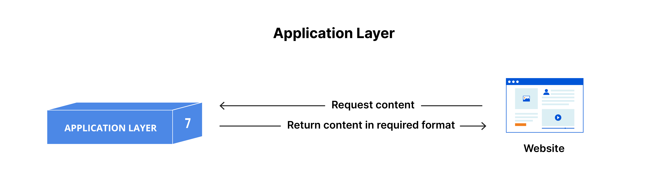
APPLICATION LAYER

Slide 29
OSI MODEL – SECURITY VIEW
Every layer has its own weaknesses, so defence must be applied at every layer ("defence in depth").
Layer | Security-Relevant Examples | Typical Defence
7 – Application | HTTP injection, SQL injection, phishing, malicious attachments | Input validation, WAF, patching
6 – Presentation | SSL stripping, weak or outdated TLS/ciphers | Strong TLS, HSTS, disable old versions
5 – Session | Session hijacking, stolen session tokens/cookies | Secure cookies, timeouts, re-authentication
4 – Transport | TCP SYN flood, port scanning, UDP flood | SYN cookies, rate limiting, firewalls
3 – Network | IP spoofing, ICMP flood, route hijacking | Ingress/egress filtering, ACLs, IPsec
2 – Data Link | ARP spoofing, MAC flooding, VLAN hopping | Static ARP, port security, DAI
1 – Physical | Cable tapping, jamming, rogue devices, theft | Physical access control, CCTV, locked racks

Slide 30
SECURITY ATTACK LAYER-2 (ARP SPOOFING)
What is ARP and ARP Cache?
Address Resolution Protocol (ARP) is a protocol that enables network communications to reach a specific device on the network. ARP translates Internet Protocol (IP) addresses to a Media Access Control (MAC) address, and vice versa. Most commonly, devices use ARP to contact the router or gateway that enables them to connect to the Internet.
Hosts maintain an ARP cache, a mapping table between IP addresses and MAC addresses, and use it to connect to destinations on the network. If the host doesn’t know the MAC address for a certain IP address, it sends out an ARP request packet, asking other machines on the network for the matching MAC address.

Slide 31
SECURITY ATTACK LAYER-2 (ARP SPOOFING)
An ARP spoofing, also known as ARP poisoning, is a Man in the Middle (MitM) attack that allows attackers to intercept communication between network devices. The attack works as follows:
1. The attacker must have access to the network. They scan the network to determine the IP addresses of at least two devices⁠—let’s say these are a workstation and a router.
2. The attacker uses a spoofing tool, such as Arpspoof or Ettercap, to send out forged ARP responses.

Slide 32
SECURITY ATTACK LAYER-2 (ARP SPOOFING)
3. The forged responses advertise that the correct MAC address for both IP addresses, belonging to the router and workstation, is the attacker’s MAC address. This fools both router and workstation to connect to the attacker’s machine, instead of to each other.
4. The two devices update their ARP cache entries and from that point onwards, communicate with the attacker instead of directly with each other.
5. The attacker is now secretly in the middle of all communications.

Slide 33
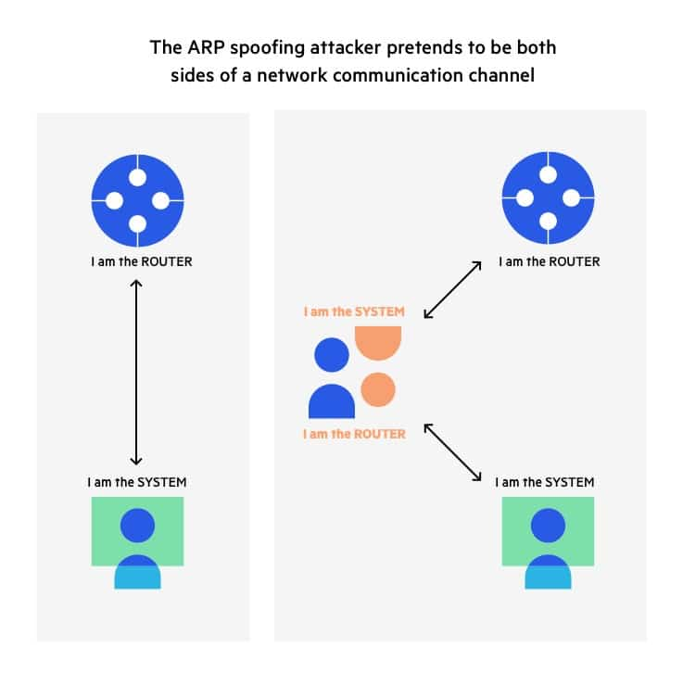
SECURITY ATTACK LAYER-2 (ARP SPOOFING)

Slide 34
SECURITY ATTACK LAYER-2 (ARP SPOOFING)
ARP SPOOFING ATTACK PREVENTION:
Here are a few best practices that can help you prevent ARP Spoofing on your network:
Use a Virtual Private Network (VPN)⁠—a VPN allows devices to connect to the Internet through an encrypted tunnel. This makes all communication encrypted, and worthless for an ARP spoofing attacker.
Use static ARP⁠—the ARP protocol lets you define a static ARP entry for an IP address, and prevent devices from listening on ARP responses for that address. For example, if a workstation always connects to the same router, you can define a static ARP entry for that router, preventing an attack.
Use packet filtering⁠—packet filtering solutions can identify poisoned ARP packets by seeing that they contain conflicting source information, and stop them before they reach devices on your network.

Slide 35
SECURITY ATTACK LAYER-3 (IP SPOOFING)
IP spoofing is the creation of Internet Protocol (IP) packets which have a modified source address in order to either hide the identity of the sender, to impersonate another computer system, or both. It is a technique often used by bad actors to invoke DDoS attacks against a target device or the surrounding infrastructure.
Sending and receiving IP packets is a primary way in which networked computers and other devices communicate, and constitutes the basis of the modern internet. All IP packets contain a header which precedes the body of the packet and contains important routing information, including the source address. In a normal packet, the source IP address is the address of the sender of the packet. If the packet has been spoofed, the source address will be forged.

Slide 36
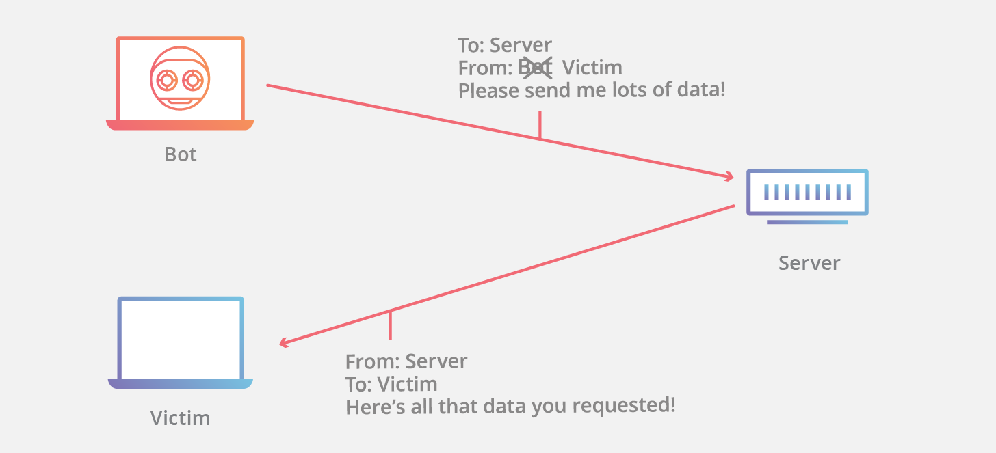
SECURITY ATTACK LAYER-3 (IP SPOOFING)

Slide 37
SECURITY ATTACK LAYER-3 (IP SPOOFING)
IP SPOOFING ATTACK PREVENTION:
A very common defence against spoofing is ingress filtering. Ingress filtering is a form of packet filtering usually implemented on a network edge device which examines incoming IP packets and looks at their source headers. If the source headers on those packets don’t match their origin or they otherwise look fishy, the packets are rejected. Some networks will also implement egress filtering, which looks at IP packets exiting the network, ensuring that those packets have legitimate source headers to prevent someone within the network from launching an outbound malicious attack using IP spoofing.

Slide 38
SECURITY ATTACK LAYER-4 (TCP SYN FLOOD)
A TCP SYN Flood attack seeks to exploit the TCP three-way handshake mechanism, which is foundational for establishing connections in TCP/IP networks. The handshake involves three steps:
A client sends a SYN (synchronize) message to a server, indicating a desire to establish a connection.
The server acknowledges this request by sending a SYN-ACK message back to the client.
The client responds with an ACK (acknowledgment), and the connection is officially established.

Slide 39
SECURITY ATTACK LAYER-4 (TCP SYN FLOOD)
In a TCP SYN Flood attack, the malicious entity sends a barrage of SYN requests to a target server but intentionally avoids sending the final ACK. This leaves the server waiting for a response that never comes, consuming resources for each of these half-open connections.
Impact on Network:
The primary objective of a TCP SYN Flood is resource exhaustion. As the server continues to allocate resources for these half-open connections, it becomes increasingly strained, eventually reaching a point where it cannot respond to legitimate traffic. This results in:
Service Disruption: Legitimate users find it difficult or impossible to access the affected service.
Resource Strain: The server’s resources, including memory and processing power, are consumed by the flood of bogus requests.
Potential System Failures: In extreme cases, the server might crash or malfunction due to the overwhelming number of half-open connections.

Slide 40
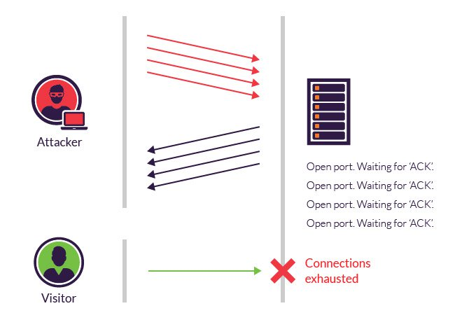
SECURITY ATTACK LAYER-4 (TCP SYN FLOOD)

Slide 41
SECURITY ATTACK LAYER-4 (TCP SYN FLOOD)
TCP SYN Flood Attack Prevention:
SYN Cookies: Use cryptographic hashing to verify connection requests before allocating any server memory.
Rate Limiting: Restrict the number of incoming SYN packets allowed per second from a single source or overall.
Adjust Timers and Backlog: Increase the size of the SYN backlog queue and reduce the SYN-RECEIVED timeout duration to clear half-open connections faster.
Cloud Protection: Route traffic through cloud-based security providers like Cloudflare to absorb and manage handshakes before they reach your primary infrastructure.

Slide 42
SECURITY ATTACK LAYER-7 (HTTP INJECTION)
HTTP response header injection vulnerabilities arise when user-supplied data is copied into a response header in an unsafe way. If an attacker can inject newline characters into the header, then they can inject new HTTP headers and also, by injecting an empty line, break out of the headers into the message body and write arbitrary content into the application's response.
Various kinds of attack can be delivered via HTTP response header injection vulnerabilities. Any attack that can be delivered via cross-site scripting can usually be delivered via response header injection, because the attacker can construct a request that causes arbitrary JavaScript to appear within the response body. Further, it is sometimes possible to leverage response header injection vulnerabilities to poison the cache of any proxy server via which users access the application. Here, an attacker sends a crafted request that results in a "split" response containing arbitrary content. If the proxy server can be manipulated to associate the injected response with another URL used within the application, then the attacker can perform a "stored" attack against this URL, which will compromise other users who request that URL in future.

Slide 43
SECURITY ATTACK LAYER-7 (HTTP INJECTION)
HTTP INJECTION PREVENTION:
If possible, applications should avoid copying user-controllable data into HTTP response headers. If this is unavoidable, then the data should be strictly validated to prevent response header injection attacks. In most situations, it will be appropriate to allow only short alphanumeric strings to be copied into headers, and any other input should be rejected.

Slide 44
TCP/IP PROTOCOL
What is the TCP/IP Protocol Suite?
The TCP/IP Protocol Suite is a set of protocols that govern how data is sent and received across networks.
It is the practical implementation of network communication, using a four-layer model.
The TCP/IP model is a simplified and more practical version of the OSI model and is used universally for internet communication.
It includes protocols that dictate how data should be packaged, transmitted, routed, and received.

Slide 45
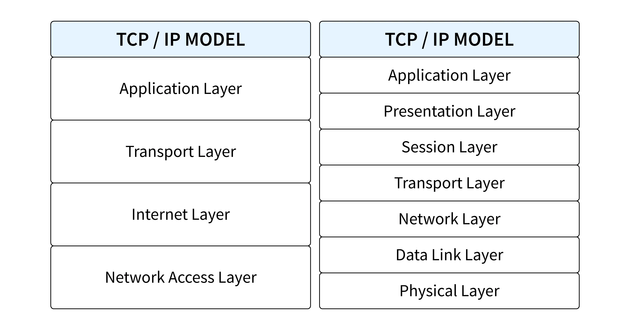
TCP/IP PROTOCOL

Slide 46
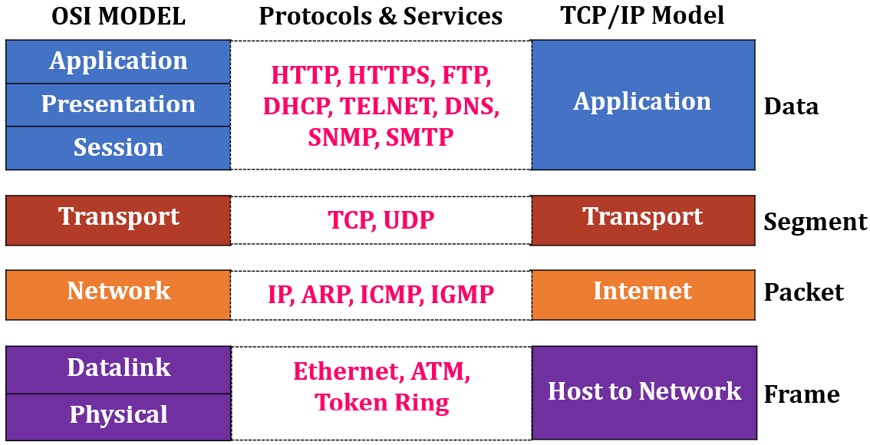
TCP/IP PROTOCOL

Slide 47
TCP/IP PROTOCOL
Importance of the TCP/IP Protocol Suite
Foundation of the Internet: TCP/IP is the protocol that powers the internet. Every website you access, every email you send, and every file you download uses TCP/IP.
Scalability: TCP/IP supports large, scalable networks like the internet, allowing it to manage millions of devices.
Interoperability: TCP/IP ensures that different devices, regardless of manufacturer, can communicate over the same network, ensuring global connectivity.
Flexibility: It can be used in both local networks (LAN) and wide area networks (WAN), offering flexibility across different network sizes and types.

Slide 48
TCP/IP PROTOCOL
Layers of the TCP/IP Protocol Suite
The TCP/IP model consists of four layers, each of which corresponds to functions in the OSI model. However, unlike the OSI model’s seven layers, the TCP/IP model simplifies the functions into four distinct groups.
Network Access Layer (or Link Layer)
Internet Layer
Transport Layer
Application Layer

Slide 49
NETWORK ACCESS LAYER
The Network Interface Layer is the lowest layer in the TCP/IP model. It is responsible for the physical transmission of data and defining how a device connects to the network.
Function: Transmits frames of data between devices on the same network. This layer encompasses the technologies that allow the hardware (e.g., Ethernet cables, Wi-Fi radios) to send and receive signals.
Key Responsibilities:
Physical Addressing: Uses MAC addresses (Media Access Control) to identify devices on a local network.
Frame Control: Ensures that the correct data format is used for the type of network (e.g., Ethernet, Wi-Fi).
Error Detection: Detects and sometimes corrects errors that may occur during the physical transmission of data.

Slide 50
NETWORK ACCESS LAYER
Key Protocols:
Ethernet: The most commonly used wired LAN protocol.
Wi-Fi (IEEE 802.11): A widely used wireless protocol for local networks.
ARP (Address Resolution Protocol): Resolves IP addresses into MAC addresses.
Real-World Example: When you connect your laptop to Wi-Fi, the network interface layer handles how your laptop physically connects to the wireless network, using a MAC address to identify itself.

Slide 51
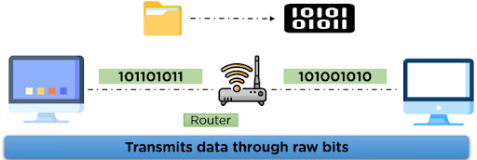
NETWORK ACCESS LAYER

Slide 52
INTERNET LAYER
The Internet Layer is responsible for moving packets of data between different networks. It manages logical addressing and routing, ensuring that data can travel across networks, not just within a local network.
Function: Routing and addressing are the key functions of the Internet Layer. It ensures that data packets can travel from the source to the destination across multiple networks.
Key Responsibilities:
IP Addressing: Uses IP addresses (logical addresses) to uniquely identify devices on different networks.
Routing: Determines the best path for data to take to reach its destination, based on the IP address.
Fragmentation: Splits large data packets into smaller ones if necessary for transmission, and reassembles them at the destination.

Slide 53
INTERNET LAYER
Key Protocols:
IP (Internet Protocol): The core protocol that provides addressing and routing.
IPv4: The most widely used version of IP, using 32-bit addresses.
IPv6: The newer version of IP, using 128-bit addresses to allow for a much larger number of devices.
ICMP (Internet Control Message Protocol): Used for error messages and diagnostic purposes (e.g., when using the “ping” command).
IGMP (Internet Group Management Protocol): Manages multicast group memberships.
Real-World Example: When you type a website address, the Internet Layer ensures that the request is routed from your device, through the internet, to the correct server based on the server's IP address.

Slide 54
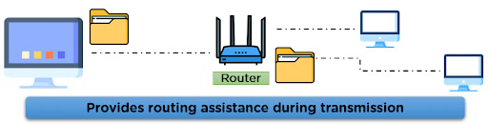
INTERNET LAYER

Slide 55
TRANSPORT LAYER
The Transport Layer is responsible for ensuring that data is delivered error-free, in sequence, and with the correct timing. It handles end-to-end communication between devices and controls how much data is sent and received.
Function: Manages data flow between devices, ensuring reliability and proper sequencing of data packets.
Key Responsibilities:
Data Segmentation: Breaks large messages into smaller segments for transmission, then reassembles them at the destination.
Error Control: Ensures that all data is received correctly; if any segments are lost, they are retransmitted.
Flow Control: Regulates the flow of data to prevent network congestion.
Multiplexing: Multiple applications on a device can use the network simultaneously, and the transport layer ensures that data is directed to the correct application.

Slide 56
TRANSPORT LAYER
Key Protocols:
TCP (Transmission Control Protocol): A connection-oriented protocol that ensures reliable delivery of data. TCP establishes a connection before transmitting data and guarantees that all segments arrive in the correct order.
UDP (User Datagram Protocol): A connectionless protocol used for scenarios where speed is more important than reliability, such as video streaming or online gaming. UDP doesn’t guarantee delivery or the correct order of segments.
Real-World Example: When you send an email, TCP ensures that all parts of the email are sent, even if it means retransmitting lost packets, and that the email is reassembled correctly at the destination.

Slide 57
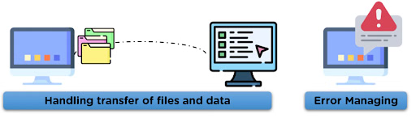
TRANSPORT LAYER

Slide 58
APPLICATION LAYER
The Application Layer in the TCP/IP model handles the interaction between the user and the network services. This is the layer where most familiar protocols, like HTTP (for web browsing), SMTP (for email), and FTP (for file transfer), operate.
Function: Provides network services directly to applications and users. This is where data is formatted, processed, and delivered to or from applications.
Key Responsibilities:
Communication with Applications: Allows applications to interact with the network. For instance, when you send an email, the application layer protocols ensure that it is formatted and transmitted correctly.
Data Formatting: Ensures that data is in a format that the receiving application can understand.
Protocol Support: Supports a wide range of protocols for different services, such as web browsing, email, and file transfer.

Slide 59
APPLICATION LAYER
Key Protocols:
HTTP/HTTPS (Hypertext Transfer Protocol / Secure): Used for accessing websites. HTTPS adds encryption for secure communication.
SMTP (Simple Mail Transfer Protocol): Used for sending emails.FTP (File Transfer Protocol): Used for transferring files between computers.
DNS (Domain Name System): Resolves human-readable domain names (like www.example.com) into IP addresses.
Real-World Example: When you browse the web, the Application Layer protocol HTTP retrieves the webpage content and displays it in your browser.

Slide 60
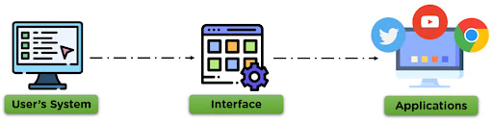
APPLICATION LAYER

Slide 61
HOW DO THESE LAYERS WORK TOGETHER?
Each layer in the TCP/IP model plays an essential role in ensuring that data is transmitted efficiently, accurately, and securely over a network.
The process starts at the Application Layer, where data is prepared for transmission, and moves down to the Transport and Internet layers, where data is segmented, addressed, and routed. Finally, the Network Interface Layer takes care of physically transmitting the data.
The recipient’s device receives the data at the Network Interface Layer and works up the layers until it reaches the Application Layer, where it is processed and delivered to the user.

Slide 62
COMPARISION OF OSI AND TCP/IP MODELS
Number of Layers
OSI Model: The OSI model has seven layers: Physical, Data Link, Network, Transport, Session, Presentation, and Application. Each layer has a clearly defined role in the communication process.
TCP/IP Model: The TCP/IP model has four layers: Network Interface, Internet, Transport, and Application. It combines some of the functions found in multiple OSI layers into broader categories.
Concept vs. Implementation
OSI Model: The OSI model is theoretical and was designed as a reference model. It is not tied to any specific protocol and is used more for educational purposes and understanding network communication.
TCP/IP Model: The TCP/IP model is practical and directly implemented in real-world networks, including the internet. It is not just a conceptual framework but a set of actual protocols used for communication.

Slide 63
COMPARISION OF OSI AND TCP/IP MODELS
Layer Functions
OSI Model:
Physical Layer deals with the transmission of raw bits over a physical medium.
Data Link Layer handles error detection and frame synchronization.
Network Layer is responsible for routing and forwarding.
Transport Layer ensures reliable transmission.
Session Layer manages sessions between applications.
Presentation Layer translates data formats.
Application Layer provides network services directly to applications.
TCP/IP model:
Network Access Layer corresponds to both the Physical and Data Link layers of the OSI model.
Internet Layer performs the routing and addressing functions of the OSI Network Layer.
Transport Layer handles reliability, flow control, and error correction, much like the OSI Transport Layer.
Application Layer combines the functions of the OSI’s Application, Presentation, and Session layers.

Slide 64
COMPARISION OF OSI AND TCP/IP MODELS
Protocol Dependency
OSI Model: The OSI model is protocol-independent and provides a general framework for how protocols should operate. It does not specify the exact protocols to be used at each layer.
TCP/IP Model: The TCP/IP model is protocol-dependent. It specifies the protocols to be used at each layer, such as:
Network Interface Layer: Ethernet, ARP, Wi-Fi.
Internet Layer: IP (IPv4/IPv6), ICMP.
Transport Layer: TCP, UDP.
Application Layer: HTTP, FTP, SMTP, DNS.

Slide 65
COMPARISION OF OSI AND TCP/IP MODELS
Error Handling and Flow Control
OSI Model: The OSI model handles error detection and flow control at both the Data Link Layer and the Transport Layer. This makes it more detailed in terms of managing errors at multiple stages of transmission.
TCP/IP Model: The TCP/IP model handles error detection and flow control only at the Transport Layer (via TCP). The Network Interface Layer handles physical transmission, but it doesn’t provide as detailed error-handling mechanisms as the OSI’s Data Link Layer.
Communication Approach
OSI Model: The OSI model follows a connection-oriented approach, especially at the Transport Layer, focusing on setting up and maintaining communication sessions between hosts.
TCP/IP Model: The TCP/IP model supports both connection-oriented (TCP) and connectionless (UDP) communication. The choice depends on the application’s needs—TCP ensures reliability, while UDP focuses on speed and efficiency.

Slide 66
COMPARISION OF OSI AND TCP/IP MODELS
Flexibility and Scalability
OSI Model: The OSI model is highly modular due to its strict separation of layers, making it more flexible in terms of design but also more complex.
TCP/IP Model: The TCP/IP model is considered less modular but more flexible in practice. Its broader layers allow for easier integration and implementation in real-world networks. It is highly scalable, which is why it became the backbone of the internet.
Data Flow
OSI Model: In the OSI model, data flow is highly structured. When data is transmitted, it passes through all seven layers from the application to the physical medium.
TCP/IP Model: In the TCP/IP model, data flow is more streamlined. Since there are fewer layers, data passes through fewer checkpoints, leading to faster transmission in practice.

Slide 67
COMPARISION OF OSI AND TCP/IP MODELS
Layer Interdependence
OSI Model: The OSI model has a strict separation between layers, which means each layer must operate independently from the others. This enhances troubleshooting and standardization but adds complexity.
TCP/IP Model: The TCP/IP model is more flexible in terms of layer interdependence. The broader layers allow protocols to interact more seamlessly, which is why TCP/IP is more efficient in practical use.

Slide 68
TCP 3-WAY HANDSHAKE
The TCP 3-Way Handshake is the process used by the Transmission Control Protocol (TCP) to establish a reliable connection between a client and a server before data transmission begins. It synchronises sequence numbers and ensures that both the client and server are ready to exchange data reliably.

Slide 69
TCP FLAGS USED IN HANDSHAKE
Flag | Purpose
SYN (Synchronize) | Initiates a TCP connection by sending the client's Initial Sequence Number (ISN).
ACK (Acknowledgment) | Acknowledges the received sequence number and confirms successful receipt of the segment.
SYN + ACK (Combination of SYN and ACK Flags) | Acknowledges the client's ISN while sending the server's own Initial Sequence Number (ISN).

Slide 70
TCP 3-WAY HANDSHAKE PROCESS
Step 1 (SYN): In the first step, the client wants to establish a connection with a server, so it sends a segment with SYN(Synchronize Sequence Number) which informs the server that the client is likely to start communication and with what sequence number it starts segments with
Step 2 (SYN + ACK): Server responds to the client request with SYN-ACK signal bits set. Acknowledgement(ACK) signifies the response of the segment it received and SYN signifies with what sequence number it is likely to start the segments with
Step 3 (ACK): In the final part client acknowledges the response of the server and they both establish a reliable connection with which they will start the actual data transfer.

Slide 71
TRANSMISSION CONTROL PROTOCOL
TCP is a reliable, connection-oriented transport protocol that ensures accurate and ordered data delivery. It uses control mechanisms to guarantee data correctness, which makes it slower but dependable.
Connection-oriented protocol
Reliable and ordered data delivery
Higher overhead but high accuracy

Slide 72
USER DATAGRAM PROTOCOL
UDP is a fast, connectionless transport protocol that sends data without reliability guarantees. It is efficient for applications where speed is more important than accuracy.
Connectionless and lightweight
No guarantee of delivery or order
Low overhead and high speed

Slide 73
TCP V/S UDP
TCP (Transmission Control Protocol) | UDP (User Datagram Protocol)
Connection-oriented; uses a three-way handshake | Connectionless; no handshake
Guarantees reliable data delivery | Does not guarantee delivery
Uses acknowledgements (ACKs) | No acknowledgements
Supports retransmission of lost packets | No retransmission support
Ensures packets are delivered in order | Does not ensure ordering
Provides flow control and congestion control | No flow or congestion control

Slide 74
TCP V/S UDP
TCP (Transmission Control Protocol) | UDP (User Datagram Protocol)
Slower due to higher overhead | Faster with minimal overhead
Variable header size (20–60 bytes) | Fixed header size (8 bytes)
Treats data as a continuous byte stream | Treats data as independent messages
Does not support broadcasting or multicasting | Supports broadcasting and multicasting
Used by HTTP, HTTPS, FTP, SMTP | Used by DNS, DHCP, VoIP, Streaming

Slide 75
IP ADDRESSING
An IP Address (Internet Protocol Address) is a unique numerical label assigned to each device connected to a computer network that uses the Internet Protocol for communication. It serves two main purposes:
Identifying a device on the network.
Locating the device to enable communication with other devices over a network like the Internet.
Components of an IP Address
Network Portion: Identifies the network to which the device belongs.
Host Portion: Identifies the individual device on the network.
Subnet Mask (for IPv4): Defines which part of the IP is network and which part is host.
Example: IP 192.168.1.10 with subnet mask 255.255.255.0
Network ID: 192.168.1.0
Host ID: 10

Slide 76
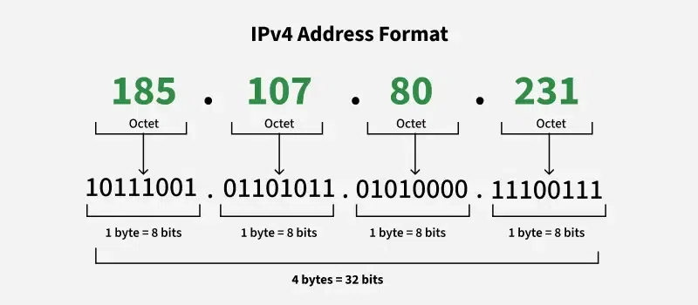
IP ADDRESSING

Slide 77
PUBLIC IP ADDRESS
A Public IP address is assigned to every device that directly accesses the internet. This address is unique across the entire internet. Uniqueness & Accessibility are its key characteristics & are assigned by Internet Service Providers. When you connect to the internet through an ISP, your device or router receives a public IP address. These addresses can be static or dynamic.
Example Use: If you host a website on your own server at home, your ISP must assign a public IP address to your server so users around the world can access your site.

Slide 78
PRIVATE IP ADDRESS
Private IP addresses are used within private networks and are not routable on the internet. This means that devices with private IP addresses cannot directly communicate with devices on the internet without a translating mechanism like a router performing Network Address Translation (NAT). These are only required to be unique within their own network & are used for communication between devices within the same network
Defined ranges for IPv4: 10.0.0.0 to 10.255.255.255, 172.16.0.0 to 172.31.255.255, 192.168.0.0 to 192.168.255.255
Defined ranges for IPv6: Addresses starting with FD or FC
Example Use: In a typical home network, the router assigns private IP addresses to each device (like smartphones, laptops, smart TVs) from the reserved ranges. These devices use their private IPs to communicate with each other and with the router. The router uses NAT to allow these devices to access the internet using its public IP address.

Slide 79
PUBLIC V/S PRIVATE IP ADDRESS
Private IP | Public IP
Used with LAN or Network | Used with Public Network
Not recognized over Internet | Recognized over internet
Assigned by LAN administrator | Assigned by service Provider/IANA
Unique only to LAN | Unique globally
Free of charge | Cost associated with using Public IP
Range – Class A – 10.0.0.0 to 10.255.255.255 Class B – 172.16.0.0 to 172.31.255.255 Class C – 192.168.0.0 to 192.168.255.255 | Range – Class A – 1.0.0.0 to 9.255.255.255 11.0.0.0 to 126.255.255.255 Class B – 128.0.0.0 to 172.15.255.255 172.32.0.0 to 191.255.255.255 Class C – 192.0.0.0 to 192.167.255.255 192.169.0.0 to 223.255.255.255

Slide 80
IPV4
This is the most common form of IP Address. It consists of four sets of numbers(octets) separated by dots. This format can support over 4 billion unique addresses. Each octet represents eight bits, or a byte, and can take a value from 0 to 255. This range is derived from the possible combinations of eight bits (2⁸ = 256 combinations).
Example of IPv4 Address: 192.168.1.1
192 is the first octet
168 is the second octet
1 is the third octet
1 is the fourth octet

Slide 81
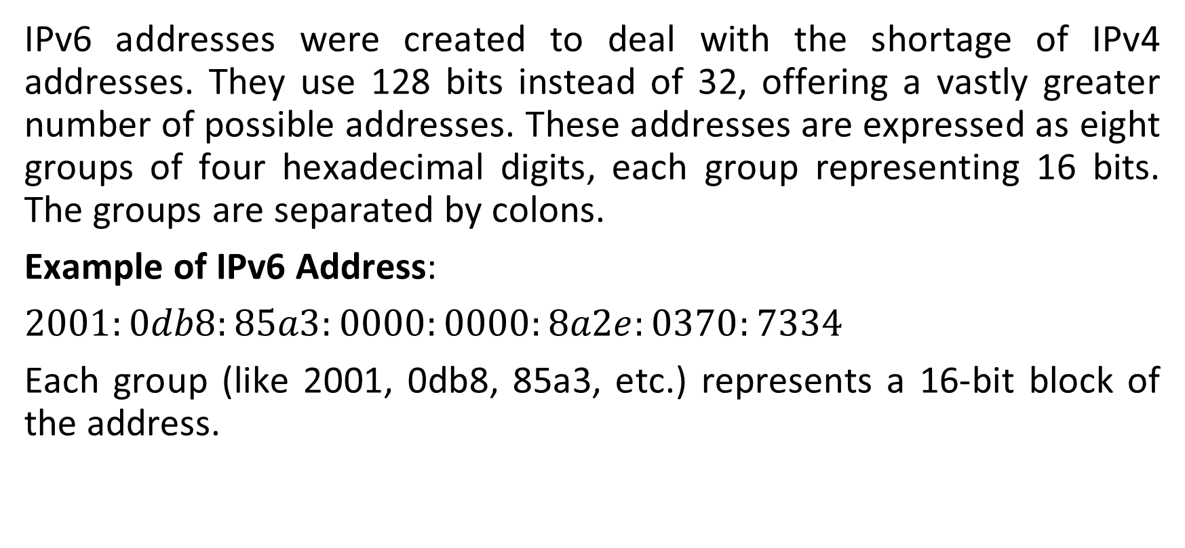
IPV6
IPv6 addresses were created to deal with the shortage of IPv4 addresses. They use 128 bits instead of 32, offering a vastly greater number of possible addresses. These addresses are expressed as eight groups of four hexadecimal digits, each group representing 16 bits. The groups are separated by colons.
Example of IPv6 Address:
$2001:0db8:85a3:0000:0000:8a2e:0370:7334$
Each group (like 2001, 0db8, 85a3, etc.) represents a 16-bit block of the address.

Slide 82
IPV4 V/S IPV6
IPv4 | IPv6
Uses a 32-bit IP address. | Uses a 128-bit IP address.
Uses decimal dot-separated notation (e.g., 192.168.0.1). | Uses hexadecimal colon-separated notation (e.g., 2001:db8::1).
Provides a limited address space of about 4.3 billion addresses. | Provides an extremely large address space for future growth.
Supports manual configuration and DHCP. | Supports SLAAC, DHCPv6, and manual configuration.
End-to-end connectivity is often affected due to NAT. | End-to-end connectivity is restored without NAT.
IPsec support is optional. | IPsec support is built into the protocol design.
Fragmentation is performed by both sender and routers. | Fragmentation is performed only by the sender.

Slide 83
IPV4 V/S IPV6
IPv4 | IPv6
Does not support flow-based packet identification. | Uses a Flow Label field for packet flow identification.
Includes a header checksum. | Does not include a header checksum.
Supports broadcast communication. | Uses multicast and anycast instead of broadcast.
Header size is variable (20–60 bytes). | Header size is fixed at 40 bytes.
Uses address classes (A, B, C, D, and E). | Does not use address classes.
Supports Variable Length Subnet Masking (VLSM). | Uses prefix-based addressing.
Example address: 66.94.29.13. | Example address: 2001:db8::1.

Slide 84
STATIC V/S DYNAMIC IP ADDRESS
Static IP Addresses
Static IP Addresses are permanently assigned to a device, typically important for servers or devices that need a constant address.
Reliable for network services that require regular access such as websites, remote management.
Dynamic IP Addresses:
Temporarily assigned from a pool of available addresses by the Dynamic Host Configuration Protocol (DHCP).
Cost-effective and efficient for providers, perfect for consumer devices that do not require permanent addresses.

Slide 85
SUBNETTING
Subnetting is the process of dividing a large IP network into smaller logical networks called subnets. Each subnet allows devices to communicate efficiently, improving network performance, security, and manageability.
Each department is assigned a separate subnet
Devices within a department communicate using their own subnet
Inter-department traffic is routed through a router
Broadcast traffic is limited to each subnet
Network performance, security, and management are improved

Slide 86
SUBNETTING
Need for subnetting:
Subnetting enables a single IP network to be divided into smaller, logical networks, allowing for efficient IP address usage, improved performance, and enhanced security control.
IP Addressing: An IP address uniquely identifies a device on a network and is divided into logical parts to support routing and communication. An IPv4 address is a 32-bit value written as four octets separated by dots (for example, 192.168.1.1).
Network portion: Identifies the network to which the device belongs
Host portion: Identifies the specific device within that network

Slide 87
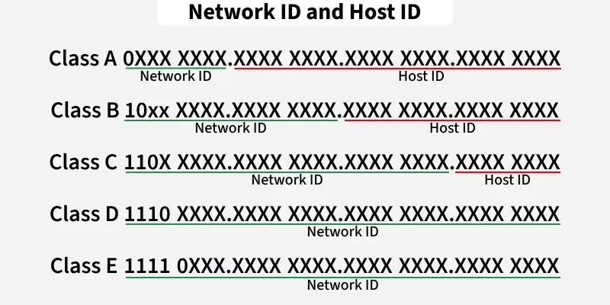
SUBNETTING
In classful IPv4 addressing, IP addresses are divided into classes based on how many bits are used for the network ID and host ID.
Class A: 8-bit network ID, 24-bit host ID
Class B: 16-bit network ID, 16-bit host ID
Class C: 24-bit network ID, 8-bit host ID

Slide 88
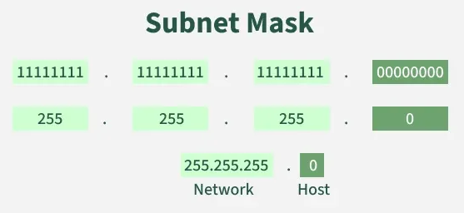
SUBNETTING
SUBNET MASK:
A subnet mask is a 32-bit number used in IP addressing to separate the network portion of an IP address from the host portion.
It helps computers and devices determine which part of an IP address refers to the network they are present,
And which part refers to their specific location or address within that network.

Slide 89
SUBNETTING
CIDR Notation: A Simplified Approach to Subnetting
Instead of using a long subnet mask (e.g., 255.255.255.0), CIDR uses a simple format like /24. The number after the slash (/n) represents the number of bits used for the network portion of the IP address.
The working of subnets starts in such a way that firstly it divides the subnets into smaller subnets. For communicating between subnets, routers are used. Each subnet allows its linked devices to communicate with each other. Subnetting for a network should be done in such a way that it does not affect the network bits.

Slide 90
SUBNETTING
In class C the first 3 octets are network bits so it remains as it is.
For Subnet-1: The first bit which is chosen from the host id part is zero and the range will be from (193.1.2.00000000 till you get all 1's in the host ID part i.e, 193.1.2.01111111) except for the first bit which is chosen zero for subnet id part.
Thus, the range of subnet 1 is: 193.1.2.0 to 193.1.2.127
Subnet id of Subnet 1 is: 193.1.2.0
The direct Broadcast id of Subnet-1 is: 193.1.2.127
The total number of hosts possible is: 126 (Out of 128, 2 id's are used for Subnet id & Direct Broadcast id)
The subnet mask of Subnet- 1 is: 255.255.255.128

Slide 91
SUBNETTING – CIDR QUICK REFERENCE
CIDR /n = number of network bits in the address. Usable hosts = 2^(32 − n) − 2 (one address for the network ID, one for the broadcast).
Example: 192.168.10.0/24 → network 192.168.10.0, hosts 192.168.10.1 – 192.168.10.254, broadcast 192.168.10.255.
CIDR | Subnet Mask | Host Bits | Usable Hosts | Typical Use
/8 | 255.0.0.0 | 24 | 16,777,214 | Class A size network
/16 | 255.255.0.0 | 16 | 65,534 | Class B size network
/24 | 255.255.255.0 | 8 | 254 | Class C size / typical LAN
/25 | 255.255.255.128 | 7 | 126 | Half of a /24 (two subnets)
/26 | 255.255.255.192 | 6 | 62 | Quarter of a /24
/30 | 255.255.255.252 | 2 | 2 | Router-to-router links

Slide 92
NETWORK ADDRESS TRANSLATION (NAT)
Concept: NAT lets many devices with private IP addresses share one public IP address when they access the Internet. It runs on the router/firewall at the network edge.
How it works: The router replaces the private source IP and port with its public IP and a unique port, then records this in a NAT table. When the reply returns, the table is used to forward it to the correct internal device.
Types: Static NAT (one private ↔ one public), Dynamic NAT (pool of public IPs) and PAT / NAT Overload (many devices ↔ one public IP using port numbers – the most common type at home and office).
Security relevance: Internal addresses stay hidden and unsolicited inbound connections are dropped by default; it also slows IPv4 exhaustion. However, NAT is not a firewall, and port forwarding re-exposes internal services.
Laptop (private)
192.168.1.10:50500
Router performs NAT
192.168.1.10:50500
↔ 203.0.113.5:40001
Internet (public)
203.0.113.5:40001

Slide 93
WELL KNOWN PORTS
Port number is a 16-bit numerical value that ranges from 0 to 65535.
Well-known port (0-1023)
Registered port (1024-49151)
Dynamic port (49152-65535).
These ports can be opened and used by software applications and operating system services to send and receive data over networks (LAN or WAN) that employ certain protocols (eg TCP, UDP).

Slide 94
FUNCTIONS OF PORTS
When interacting over the Internet, TCP and UDP protocols make connections, recompile data packages after the transfer, and then deliver them to applications on the recipient's device.
For this handover to work, the operating system must install and open the gateway for the transfer. Each door has a unique code number.
After transmission, the receiving system uses the port number to determine where the data should be sent. The port numbers of the sender and receiver are always included in the data packet.
Ports are assigned sequential numbers from 0 to 65535. Some of these codes are standardized, meaning they are assigned to certain uses.
Since code numbers are universally recognized and permanently assigned, these standard ports are also known as well-known ports.

Slide 95
SIGNIFICANT PORT NUMBERS
Some of the significant ports are:
Port Number | Service Name | Transport Protocol | Description
20/21 | FTP-data/ FTP | TCP, SCTP/ TCP, UDP, SCTP | File Transfer Protocol data transfer / File Transfer Protocol (FTP) control connection
22 | SSH-SCP | TCP, UDP, SCTP | Secure Shell, secure logins, file transfers (scp, sftp), and port forwarding
23 | Telnet | TCP | Telnet protocol—unencrypted text communications
25 | SMTP | TCP | Simple Mail Transfer Protocol, used for email routing between mail servers
53 | DNS | TCP, UDP | Domain Name System name resolver

Slide 96
SIGNIFICANT PORT NUMBERS
Port Number | Service Name | Transport Protocol | Description
80 | HTTP | TCP, UDP, SCTP | Hypertext Transfer Protocol (HTTP) uses TCP in versions 1.x and 2. HTTP/3 uses QUIC, a transport protocol on top of UDP
110 | POP3 | TCP | Post Office Protocol, version 3 (POP3)
143 | IMAP4 | TCP, UDP | Internet Message Access Protocol (IMAP), management of electronic mail messages on a server
443 | HTTP over SSL | TCP, UDP, SCTP | Hypertext Transfer Protocol Secure (HTTPS) uses TCP in versions 1.x and 2. HTTP/3 uses QUIC, a transport protocol on top of UDP.
445 | Microsoft-DS (SMB) | TCP | Microsoft Directory Services (SMB – Server Message Block) is used for file sharing, printer sharing, and communication with Windows network services. It commonly supports SMB-based file and resource sharing over TCP.

Slide 97
OPEN PORTS AS ATTACK SURFACE
Attack surface is the total of all points where an attacker can try to enter a system or extract data from it.
A port is open when a service is listening on it and accepts connections. Every open port means a running service, and every service is a potential entry point.
Why open ports are risky:
Unpatched or vulnerable service software (e.g., old SMB or web server versions)
Weak or default credentials on remote-access services (SSH, RDP, Telnet, FTP)
Misconfiguration such as anonymous FTP, open file shares, or a mail server acting as an open relay
Clear-text legacy protocols that leak passwords; service banners that reveal software versions
Real-world cases: WannaCry ransomware (2017) spread through exposed SMB port 445; exposed RDP port 3389 is a favourite entry point for ransomware gangs.
Principle: Fewer open ports = smaller attack surface. Keep only the ports that are really needed, and restrict them with a firewall.

Slide 98
OPEN PORTS – COMMON RISKS
Port | Service | Main Risk | Mitigation
21 | FTP | Clear-text credentials, anonymous login | Use SFTP/FTPS, disable anonymous access
22 | SSH | Brute-force attacks on weak passwords | Key-based login, disable root login, restrict by IP
23 | Telnet | All traffic including passwords in clear text | Disable it; use SSH instead
25 | SMTP | Open relay, spam and phishing delivery | Require authentication, SPF/DKIM/DMARC
53 | DNS | Cache poisoning, DDoS amplification, zone transfer leaks | Restrict zone transfers, DNSSEC, rate limiting
445 | SMB | Ransomware and worms (WannaCry / EternalBlue) | Block at perimeter, disable SMBv1, patch
3389 | RDP | Brute force, BlueKeep-type exploits | VPN or gateway, MFA, NLA; never expose directly

Slide 99
PORT SCANNING
Port scanning probes a host to find which ports are open, closed or filtered and which services run on them. Attackers use it for reconnaissance; administrators use it for audits (tool: Nmap).
Open – a service replies | Closed – the host replies with RST (nothing listening) | Filtered – a firewall silently drops the probe.
Scan Type | How it uses the handshake | Response
TCP connect (-sT) | Completes the full SYN → SYN-ACK → ACK handshake | SYN-ACK = open, RST = closed (easily logged)
SYN / half-open (-sS) | Sends SYN, then RST instead of the final ACK | SYN-ACK = open, RST = closed (stealthier)
UDP scan (-sU) | No handshake exists for UDP | ICMP "port unreachable" = closed; silence = open/filtered
Defence: close unused ports, use firewalls and IDS/IPS to detect scan patterns, rate-limit probes. Scan only systems you own or have written permission to test.

Slide 100
DNS – RESOLUTION PROCESS
The Domain Name System (DNS) translates human-readable names (www.example.com) into IP addresses – the "phonebook of the Internet". It mainly uses UDP/TCP port 53.
Step 1: Browser checks its own cache, then the OS cache and hosts file.
Step 2: If not found, the query goes to the recursive resolver (ISP DNS, or public ones such as 8.8.8.8 / 1.1.1.1).
Step 3: The resolver asks a Root server, which points to the .com TLD server.
Step 4: The TLD server points to the authoritative name server of example.com.
Step 5: The authoritative server returns the IP address (A record).
Step 6: The resolver caches the answer (for its TTL) and returns the IP to the browser, which then connects to the web server.
Security note: Classic DNS is unencrypted and unauthenticated, so responses can be forged – this is what makes DNS poisoning possible.

Slide 101
DNS – RECORD TYPES
Record | Name | Purpose | Example
A | Address | Maps a domain name to an IPv4 address | example.com → 93.184.216.34
AAAA | IPv6 Address | Maps a domain name to an IPv6 address | example.com → 2001:db8::1
MX | Mail Exchanger | Mail servers that accept email for the domain (with priority) | 10 mail.example.com
CNAME | Canonical Name | Alias that points one name to another name | www → example.com
TXT | Text | Free text; used for SPF, DKIM, DMARC and domain verification | "v=spf1 include:_spf.example.com ~all"
NS | Name Server | Authoritative name servers for the domain | ns1.example.com
Security relevance: attackers enumerate DNS records during reconnaissance; TXT records (SPF/DKIM/DMARC) help stop email spoofing; a dangling CNAME can allow subdomain takeover.

Slide 102
DNS – POISONING CONCEPT
DNS poisoning (cache poisoning / DNS spoofing) means inserting forged DNS data into a resolver's or device's cache so that a genuine domain name resolves to an attacker's IP address.
How it works:
Attacker sends forged DNS replies to a resolver, trying to beat the real server (guessing the transaction ID / port).
The resolver accepts the fake answer and caches it until the TTL expires.
Every user of that resolver who asks for bank.com is sent to the attacker's fake site, although the URL typed is correct.
Impact: credential theft, malware delivery, man-in-the-middle attacks, redirection of email.
Other forms: edited hosts file, rogue DNS settings pushed via a hacked router or rogue DHCP, and LAN attacks combined with ARP spoofing.
Prevention: DNSSEC (signed records), randomised source ports and transaction IDs, patched DNS software, DNS over HTTPS/TLS, secured routers, and never ignoring browser certificate warnings.

Slide 103
HTTP – REQUEST AND RESPONSE
HTTP is a stateless, application-layer client–server protocol (port 80). The client sends a request and the server returns a response. Each message has a start line, headers, a blank line and an optional body.
Common methods: GET (fetch), POST (send data), PUT (update), DELETE (remove), HEAD (headers only).
HTTP Request
POST /login HTTP/1.1
Host: www.example.com
User-Agent: Mozilla/5.0
Cookie: sessionid=abc123
user=alice&pass=Pass@123
HTTP Response
HTTP/1.1 200 OK
Content-Type: text/html
Set-Cookie: sessionid=xyz789
Server: nginx
<html> ... page content ... </html>
Security note: over plain HTTP everything above – including the password and cookie – can be read by anyone on the network path.

Slide 104
HTTP – STATUS CODES
Class | Meaning | Common Codes
1xx – Informational | Request received, continuing | 100 Continue
2xx – Success | Request completed successfully | 200 OK, 201 Created
3xx – Redirection | Further action is needed | 301 Moved Permanently, 302 Found, 304 Not Modified
4xx – Client Error | Problem with the request | 400 Bad Request, 401 Unauthorized, 403 Forbidden, 404 Not Found
5xx – Server Error | Server failed to complete a valid request | 500 Internal Server Error, 502 Bad Gateway, 503 Service Unavailable
Security relevance
Repeated 401/403 → password guessing or access-control probing. Many 404s → directory scanning.
500 errors may leak stack traces and software versions. 301/302 redirects can be abused in phishing (open redirect).

Slide 105
HTTP – COOKIES AND SESSIONS
HTTP is stateless: the server does not remember a user between requests. Cookies and sessions add memory.
Cookie: a small piece of data the server sends (Set-Cookie); the browser stores it and returns it with every later request to that site (preferences, login state, tracking).
Session: a server-side record of a user's logged-in state, identified by a Session ID that is normally kept in a cookie.
Flow: Login → server creates session and sends Session ID cookie → browser sends the cookie on each request → server looks up the session.
Attacks: Session hijacking (a stolen Session ID gives access without the password – via XSS, sniffing on HTTP or malware), session fixation, and CSRF.
Cookie flags: Secure (sent only over HTTPS), HttpOnly (hidden from JavaScript), SameSite (limits cross-site sending), plus an expiry time.
Defence: use HTTPS, regenerate the Session ID after login, set timeouts, and invalidate the session on logout.

Slide 106
HTTP V/S HTTPS
Feature | HTTP | HTTPS
Full form | Hypertext Transfer Protocol | HTTP Secure (HTTP over TLS)
Default port | 80 | 443
Encryption | None – data travels in plain text | Encrypted using TLS
Server identity | Not verified | Verified using a digital certificate
Data integrity | Can be altered in transit unnoticed | Tampering is detected
Certificate needed | No | Yes (issued by a CA)
Attack exposure | Sniffing, man-in-the-middle, session hijacking | Protects data in transit against these
Browser indicator | "Not secure" warning | Padlock icon

Slide 107
HTTPS – PROTECTION AND LIMITS
HTTPS DOES protect
Confidentiality: traffic is encrypted, so sniffers on public Wi-Fi see only ciphertext
Integrity: any modification in transit is detected
Authentication: the certificate proves you reached the real server
Passwords, cookies and form data are protected in transit
Blocks most man-in-the-middle and content-injection attacks on the path
HTTPS does NOT protect
Malicious sites: phishing sites can also have valid certificates – the padlock does not mean "safe"
Web-app flaws: SQL injection and XSS still work, because the attack is encrypted too
Endpoints: malware on the client or server, stolen credentials, weak passwords
Metadata: IP addresses, domain name (DNS/SNI) and traffic volume remain visible
Data is plain once decrypted on the server – insecure storage can still leak it

Slide 108
DIGITAL CERTIFICATES
A digital certificate (X.509) binds a public key to an identity (a domain or organisation). It is issued and digitally signed by a trusted Certificate Authority (CA) and lets the browser verify who the server really is.
Contents: Subject (domain / organisation), Public key, Issuer (CA), Validity period (from – to), Serial number, Signature algorithm and the CA's digital signature.
Types by validation: DV (domain only), OV (organisation checked), EV (extended checks).
Browser checks: trusted CA signature, domain name match, not expired, not revoked (CRL / OCSP). Failures (expired, self-signed, mismatched) trigger a warning – do not click through.
Root CA
Pre-installed in the OS / browser trust store
Intermediate CA
Signed by the Root CA
Server (leaf) certificate
Signed by the Intermediate CA

Slide 109
HTTPS – TLS HANDSHAKE (SIMPLIFIED)
Step 1 – Client Hello: the browser sends its supported TLS versions, cipher suites and a random number.
Step 2 – Server Hello + Certificate: the server selects the cipher suite and sends its digital certificate containing the public key.
Step 3 – Certificate verification: the browser validates the CA signature chain, domain name, validity period and revocation status.
Step 4 – Key exchange: both sides agree on a shared secret (ephemeral Diffie-Hellman in TLS 1.3) and derive session keys.
Step 5 – Finished: both confirm the handshake; from now on HTTP data is encrypted with fast symmetric keys (e.g., AES).
Remember: asymmetric cryptography authenticates the server and exchanges keys; symmetric cryptography encrypts the bulk data. TLS 1.3 needs only one round trip; SSL and TLS 1.0/1.1 are deprecated and must be disabled.

Slide 110
PACKET FLOW
Browser
PC / phone
Gateway
Router + NAT
ISP
Internet provider
Internet
Many routers
Web Server
example.com
DNS lookup: the browser resolves the domain name to an IP address (UDP port 53).
Connection: TCP 3-way handshake with the server (port 443), then the TLS handshake for HTTPS.
Encapsulation: data → segment (TCP, ports) → packet (IP addresses) → frame (MAC addresses) → bits.
ARP: the PC finds the MAC address of its default gateway and sends the frame to the router.
Routing: the router applies NAT; each router then forwards the packet by IP, lowers the TTL by 1 and rewrites the MAC addresses hop by hop.
Server and return path: the server de-encapsulates layer by layer, builds the response and sends it back; the NAT table delivers it to the right device.

Slide 111
PACKET FLOW – PRACTICAL TRACING
Tracing shows the path a packet takes and where it is delayed or blocked. It is used to verify firewall rules, spot unexpected routes and investigate suspicious traffic.
Traceroute idea: it sends packets with TTL 1, 2, 3 …; each router that reduces the TTL to 0 returns an ICMP "Time Exceeded" message, revealing its address. A line of * * * means that hop is filtered or not replying.
Tool | Example Command | What It Shows
ping | ping example.com | Reachability and round-trip time (ICMP)
tracert / traceroute | tracert example.com | Each router hop and its latency
nslookup / dig | nslookup example.com | DNS answers and record types
netstat / ss | netstat -an | Active connections and listening (open) ports
arp | arp -a | IP-to-MAC table; duplicate MACs hint at ARP spoofing
Wireshark | capture + display filter | Packets, handshakes, DNS and HTTP layer by layer

Slide 112

ANY QUERIES??
Contact
gayathri.g@techdefence.com

Slide 113


